Slide 1
Notes:
%\printinunitsof{cm}\prntlen{\textwidth}

Slide 4
Notes:
With this property of exponentials, if you can remember the values of $2^1$ to $2^{10}$ then you can approximate most values of $2^b$ that you come across in communications and security. Table~\ref{table:binvalues} gives the exact or approximate decimal value for $b$-bit numbers.

Slide 5
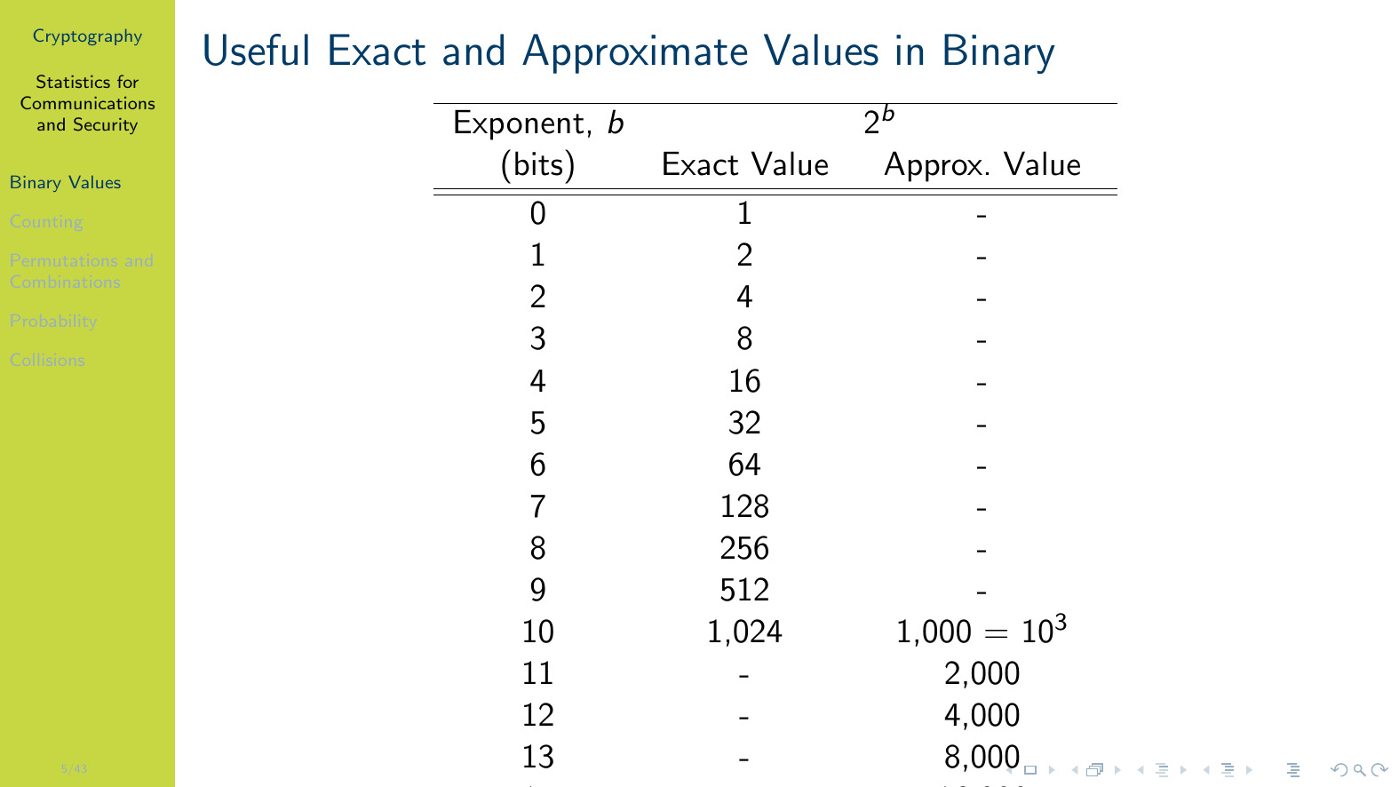

Slide 41
Notes:
Defintion~\ref{stats:def:birthday} can be re-arranged to find the number of values needed to obtain a specified probability that at least two numbers are the same: \\~\ \[ n(p; d) \approx \sqrt{2d \ln\left(\frac{1}{1-p}\right)} \]

Slide 43
Notes:
Following Example~\ref{stats:ex:birthday:hash}, the number of attempts to produce a collision when using an $n$-bit hash function is approximately $2^{n/2}$.

