Slide 1
Notes:
%\printinunitsof{cm}\prntlen{\textwidth}

Slide 3
Notes:
The constraints on $a$ and $b$ specify the relationship between the values, i.e.\ you cannot necessarily choose any values. We will not go into that detail here.

Slide 4
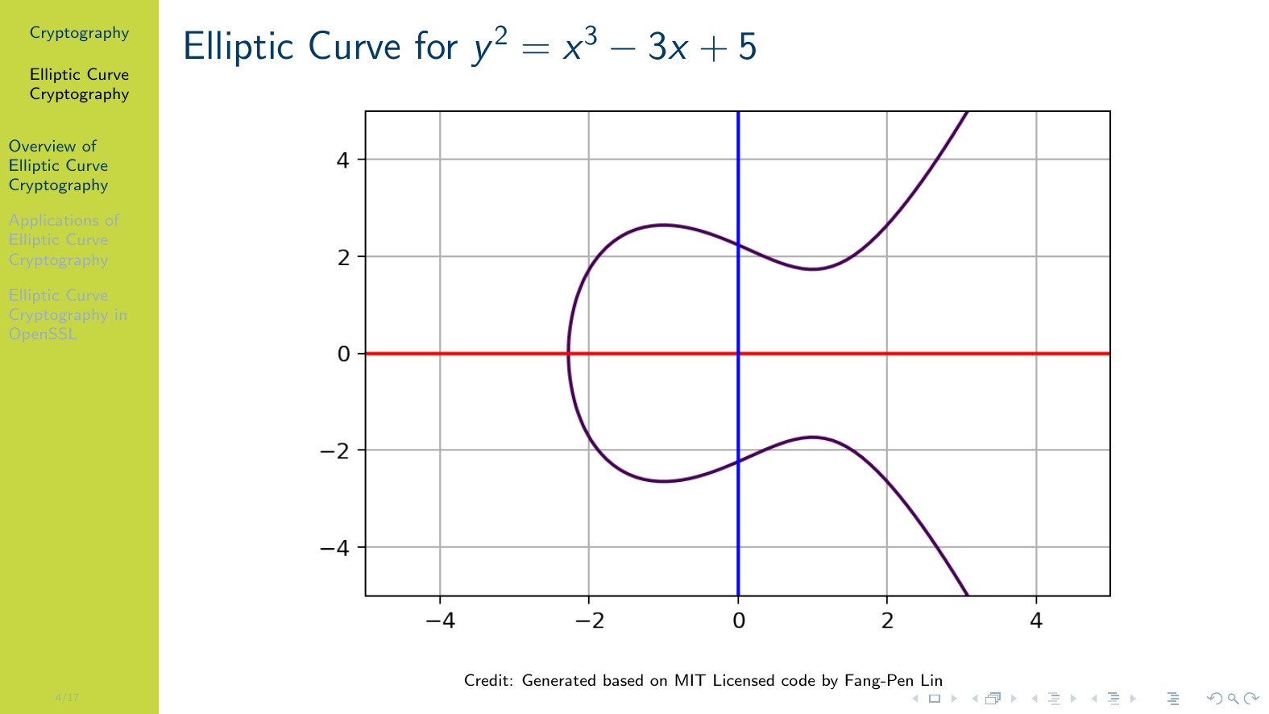
Notes:
\figurename~\ref{fig:elliptic:demo1} shows an example elliptic curve where $a=-3$ and $b=5$, plotted for $x$ values from -4 to 4. An elliptic curve always mirrors itself about the horizontal (red) axis.

Slide 5
Notes:
See the following figure for an example of this concept. Note the points, A, B, R and -R are just $(x,y)$ coordinates.

Slide 6
Notes:
\figurename~\ref{fig:elliptic:demo2} shows the concept of addition. Adding the points A and B results in the point shown as A+B. There is always a third point that intersects the curve on the line between A and B, and there is always an inverse of this point. \\~\ Note that we could continue the addition. For example, with A+B, add another point C, to arrive at a new point A+B+C. And so on.

Slide 7
Notes:
\figurename~\ref{fig:elliptic:demo3} shows the self addition of point P. When adding a single point P to itself, the line that intersects P is chosen as the line tangent to P. So P+P = 2P. \\~\ We can continue to add P.

Slide 8
Notes:
\figurename~\ref{fig:elliptic:demo4} shows P + 2P = 3P. Then we can add P again to get 4P and so on.

Slide 9
Notes:
\figurename~\ref{fig:elliptic:demo5} shows NP. In this example N=13. That is, we start with point P, and add P twelve times, resulting in the point 13P.

Slide 10
Notes:
As with other public key systems, elliptic curve cryptography relies on the fact that it is easy for the user to generate the public and private key, but practically impossible for an attacker to find the private key from the public key. \\~\ Why is that the case? So far we said $NP$ is found by adding $P$ $N-1$ times, that is, takes $N-1$ addition operations. So an attacker could simply start with $P$, and keep adding $P$ until they get an answer of $NP$. Now the know how many additions, i.e.\ the private value $N$. \\~\ However if $N$ is large enough the attackers method will be practically impossible. And for the user to generate $NP$ when they know $N$, there is a shortcut that is practically achievable.

Slide 11
Notes:
In summary, knowing the $b$-bit value $N$, the user needs to perform about $2 \times b$ point additions. This is easy. But the attacker, who doesn't know $N$, must perform about $2^{b}$ point additions, which is practically impossible.

Slide 12
Notes:
The figures and examples given previously shown an elliptic curve without modular arithmetic. But in elliptic curve cryptography, modular arithmetic occurs. The same principles, and reasoning why it is hard for the attacker, still apply. The plots of the elliptic curve in modular arithmetic look different however---they now have distinct points in a finite coordinate space. Search online for examples.

Slide 14
Notes:
The most common applications are for secret key exchange, especially with \ac{ECDH}, and digital signatures with \ac{ECDSA}. We will look at ECDH in the following.

Slide 15
Notes:
Diffie-Hellman key exchange can be used using ECC so that both users obtain a shared secret over an insecure channel. Users agree on a public point $P$. They generate their own keypairs, where the private key is some large random number, and the public key is that number times $P$. Note that in the key generation, each user can use the shortcut to calculate $NP$ or $MP$. \\~\ Assume the users exchange public keys. They then use their own private key multiplied by the other's public key. Again, the shortcut point addition can be used. Both will arrive at the same point (coordinate), i.e.\ $NMP = MNP$. This is the shared secret. \\~\ An attacker that knows the public keys and initial point $P$ has to find either $N$ or $M$. If those numbers are large enough, this is practically impossible.

Slide 16
Notes:
SECG in SEC 2 defined a large set of curves. The NIST curves were a subset of the SEC 2 curves. NSA Suite B curves are a subset of NIST curves.

